Slide 1

Pancake Flipping Analysis
Sunil Kumar m

Slide 2
Objective
Arielle and Boris compete in the little-known sport of pancake flipping, and have both been nominated for this season's "best pancake flipper" award. As a Data Scientist our objective is to provide the Data Driven Analysis and suggestion on who is the better pancake flipper.
Data in Scope:
History of data from this season for both the players are taken into scope for the Analysis.
Key Insights:
Arille is good at pancake flipping using the Right Hand.
Boris was good at pancake flipping using the Left Hand initially and as the season progress he improved himself to be ambidextrous.
Arille had a better average score when compared to Boris during the first half of the season, but towards the end of the season Boris replaced his spot.
Analysis Summary

Slide 3
Data Description
The stats data collected for this analysis are as follows.
The contestant's name
The match day
Which hand they used to flip the pancakes (Right or Left)
Their score (how many pancakes they flipped successfully)
How many total pancakes they attempted to flip
Variable | Data Type | Sample Value
Name | Categorical | Arielle, Boris
Match Day | Integer | 1, 2, 3, 4….50
Hand | Categorical | R, L
Score | Integer | 3, 4, 5, 6, 14
Attempts | Integer | 20 (constant)
The sample size provided for the analysis is 100 records with equal split between both the contestants of 50 each.
Hence, the sample size is equally distributed and not biased towards any particular contestant.

Slide 4
Data Pre-processing
Checking for Null Values
Using the Pandas Dataframe, we checked for the Null values in the data and it is clearly evident that the data provided does not contain any Null values.
Checking for Duplicates records
Using the Pandas Dataframe, we checked for the Duplicate records in the data and it is clearly evident that the data provided does not contain any Duplicate records.
Checking for Constant or Primary Key Columns
Using the Pandas Dataframe, we checked for the constant values in the data and it is clearly evident that the variable ”Attempts” has constant value in all the records since, it contains minimum, maximum and mean values are same. Hence, we are dropping it from the analysis.

Slide 5
Analysis – Plan of Action
Variables considered for the analysis after the Data pre-processing are Name, Match Day, Hand and Score.
Here is the initial Plan of Action (or) the Approach for the Analysis with the given data.
Step 1: Distribution of Scores – Overall, Arielle and Boris
Step 2: Finding Correlation between Match Day and Scores – Overall, Arielle and Boris.
Step 3: Finding Proportion of Right Hand or Left Hand usage between Arielle and Boris.
Step 4: Creating Additional Derived Variables, when required.

Slide 6
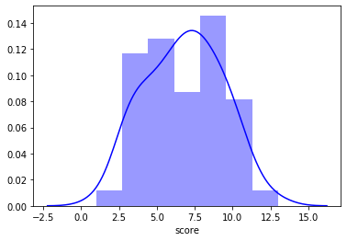
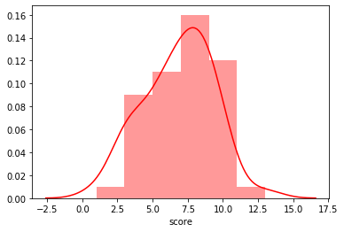
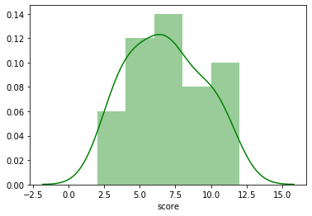
Step 1 – Distribution of Scores
Overall Score Distribution
Arielle Score Distribution
Boris Score Distribution
Overall score in the given sample is normally distributed since, the mean, median and mode remains at its peak.
Arielle score in the given sample is left or negatively skewed since, the mean is also at the left of its peak.
Boris score in the given sample is right or positively skewed since, the mean also remains at the right of its peak.

Slide 7
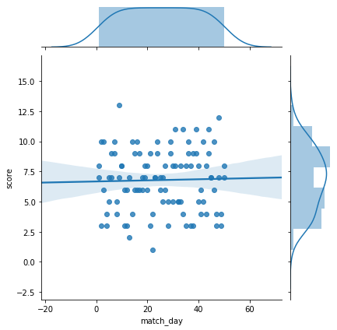
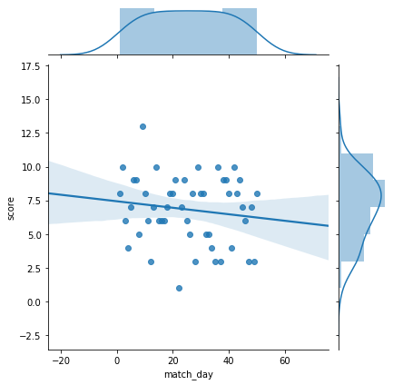
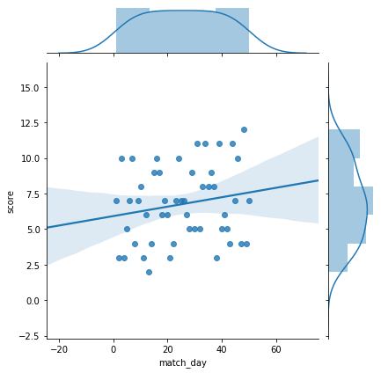
Step 2 – Finding Correlation
Match day vs score - Overall
Match day vs score - Arielle
Match day vs score - Boris
Based on the above chart, it is clearly evident that there is no correlation between Match day and Score variable for the overall data.
Based on the above chart, it is clearly evident that there is a negative corelation between Match day and Score variable for the Arielle sample.
Based on the above chart, it is clearly evident that there is a positive corelation between Match day and Score variable for the Boris sample.

Slide 8
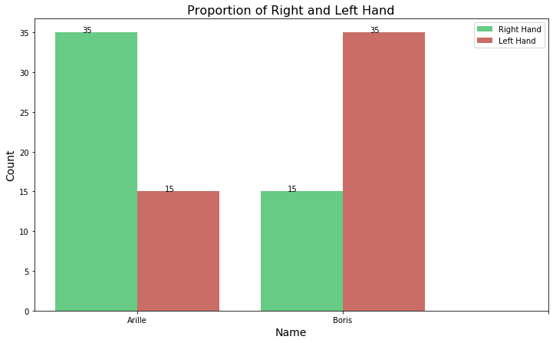
Step 3 – Proportion of Right - Left
From the chart, it is clearly evident that Arille has used Right hand in most of the games in this season. Whereas Boris has used Left hand in most of the games in this season.
And also from the previous analysis, we can see that Match Day variable shows correlation with the other variables.
So to further analyze, lets create a categorical variable Match Day Bucket from the Match Day variable(continuous).

Slide 9
Step 4 – New Categorical Variable
We have created the new categorical variable Match day bucket from the continuous variable Match day for our analysis.
The Main reason for creating this categorical variable is to simplify the analysis by comparing it with the other features.
Match Day variable | Match Day Bucket variable
1, 2, 3, 4... 10 | 1 to 10
11, 12, 13, 14… 20 | 11 to 20
21, 22, 23, 24… 30 | 21 to 30
31, 32, 33, 34… 40 | 31 to 40
41, 42, 43, 44… 50 | 41 to 50

Slide 10
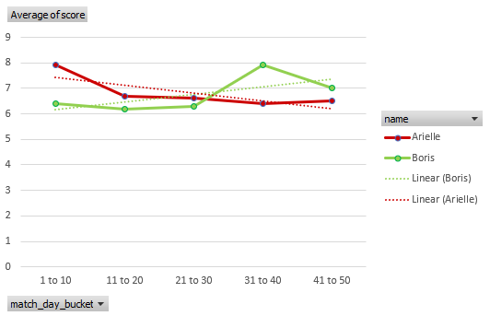
Match Day Bucket vs Avg. Score
When trying to understand the performance of the contestants over this season, it is clearly evident that Arille dominated the floor initially with high Avg. score when compared to Boris. But as the season progress Arille Avg. score seems to have a negative trend.
Whereas Boris started the season with low Avg. score and consistently showed upward trend and towards the end of the season, his Avg. score is higher than Arille.

Slide 11
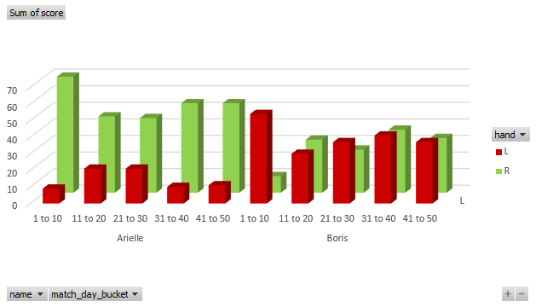
Match Day Bucket vs Hand vs Score
When trying to understand the Hand feature impact with Match Day Bucket and Score, we gathered the below insights.
Arille is good at pan flipping with right hand throughout the season and it is clearly evident that he is not good at pan flipping with left hand.
Boris was a left handed pan flipper initially during the inception of the season and as the season progress he improved himself at pan flipping with both the hands.

Slide 12
Analysis - Summary
Key Insights:
Boris score is positively skewed, whereas Arielle score is negatively skewed.
Boris score shows the positive correlation with match day, whereas Arielle score is negatively correlated.
Boris score shows the upward trend when compared with Match day Bucket, whereas Arielle shows downward trend.
Boris despite being a left hand pan flipper showed continuous improvement throughout the season in terms of scores and proved himself to be ambidextrous.
Key Suggestions:
Since, Boris showed positive trend on all the touch points from this season data, he is a better pancake flipper.
Whereas Arielle showed his strong competitiveness in pancake flipping using Right Hand consistently.
In the upcoming competitions, Boris can give tough competition to Arielle in pancake flipping using the Right Hand, whereas when comes to Left Hand pancake flipping Boris outperforms Arielle.

